Slide 1
Woodland Public Schools
Facilities and Safety Report
For September 2016

Slide 2
FACILITIES REPORT
Accident Prevention Program / Occupational training – We have completed the district Accident Prevention Program master document . The purpose of the Accident Prevention Program is to improve the skill, awareness, and competency of all Woodland School District employees in the field of occupational safety and health. This document spells out in detail how the Woodland School District manages safety activities throughout the district. The program provides an authoritative source of information to assist administrators, supervisors, and employees in their efforts to conduct business in a safe and healthy manner consistent with applicable law, rule, policy, or regulation. The elements of this program cover a broad spectrum of areas, all designed to prevent accidents and injuries.
One major change to our existing procedures (and part of the program) is the introduction of the Job Safety Analysis document. Each employee of the district will be required to complete this when they start work at the District, or reassigned to another location. The purpose of the JSA is to:
Acclimate staff members to emergency equipment in their areas (fire extinguishers, pull stations, AED’s etc.)
Identify potential hazards associated with their jobs (i.e. Chemicals, pinch hazards, heat sources, etc.)
Ergonomic risks associated with their job
Additional Safe Schools training as needed (specific to their work)
The Accident Prevention Program has been sent to the Superintendent for final review and recommend that it be added as a district procedure under the Safety policy.

Slide 3
FACILITIES REPORT
Department occupational Training
Occupational training for the entire facilities department was completed in one 8 hour training session on October 10th. This ensures that our custodians, maintenance and ground crews have the required OSHA training to perform their jobs safely.
Intermediate School Old Playground
Due to numerous serious injuries associated with the Intermediate school play structure, changes will be made to lower “monkey bars” and other play equipment, in addition the high arc bars will also be removed to make the structure more age appropriate.
More on Lead Testing
Detailed sampling was complete at the Primary and Intermediate schools to comply early with the requirement of WAC. This testing has to be completed at all schools by July 2017. We will have the required testing completed at all schools by the end of 2016. I expect to have the results of this testing by October 28th.
LED Lighting Upgrades
LED test lighting has been installed in the hallway between LRA and the yellow gym and the hallway that leads to the District office. Two wattages are being tested, then we will move forward with replacement of the currently installed incandescent and fluorescent lamps. I will complete an ROI on this once the lamps are selected.

Slide 4
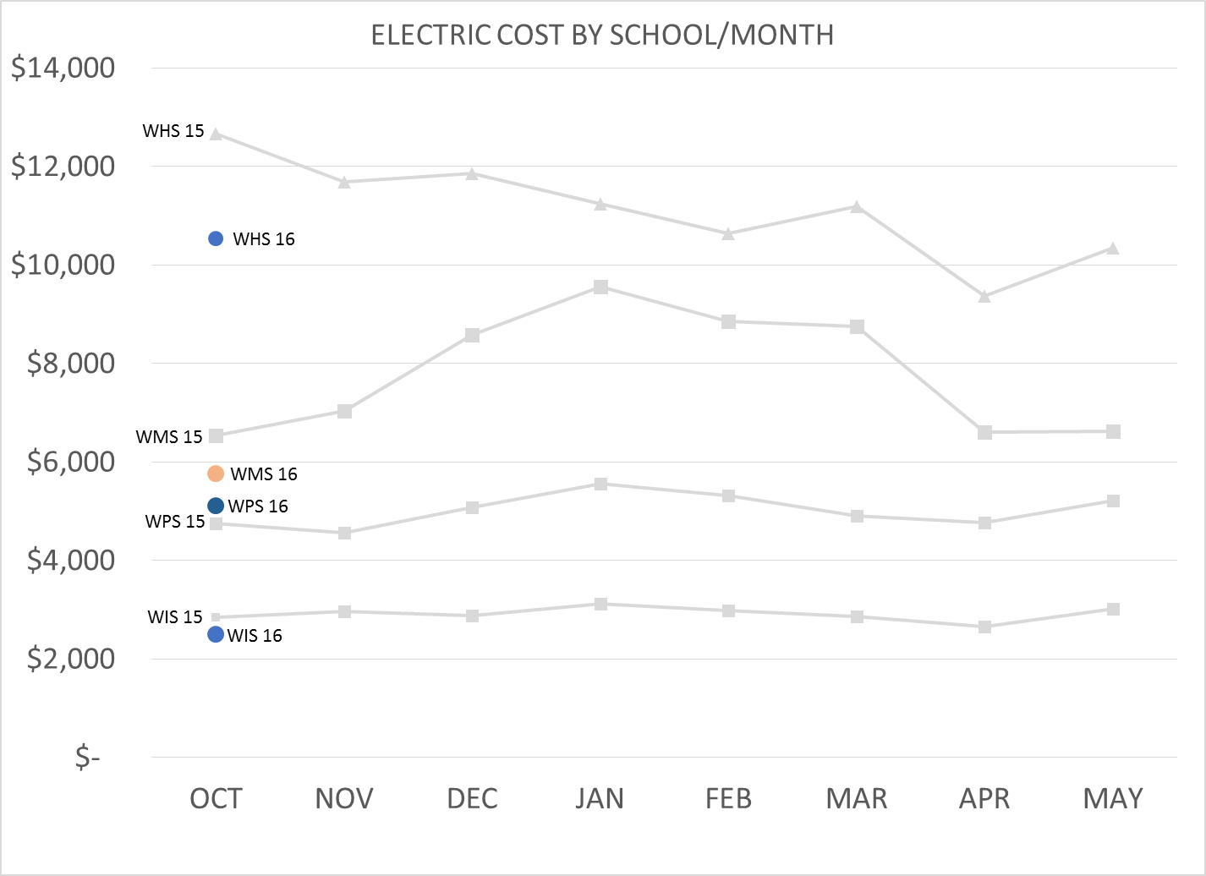

Slide 5
SAFETY
Accidents for the month
There were a total of 12 injury accidents for the month of September -5 students and 7 staff members.
Staff and Student Accident summary (12)
WPS – Student contusion to left side, fall from play equipment.
WPS – Employee slipped on drops of water in lunchroom pulled muscle.
WPS – Employee injured by angry student, student struck Paraeducator in chest
WPS – Employee struck in chest by angry student, student struck Paraeducator in chest (2X)
WPS – Employee struck in head by student throwing scissors, cut and bruise above eye
WIS - Student fell from play equipment, fractured left arm
WMS – Employee injured back from lowering lunch table, back strain
WMS – Employee tripped on transition between carpet and hard floor, strain knee and ankle
WMS – Employee slipped on binder left on floor, strain to arm, leg, back and neck
WHS – Sports injury football, head injury concussion
WHS – Sports injury football, broken collar bone
WHS – Sports injury Football, broken leg.

Slide 6
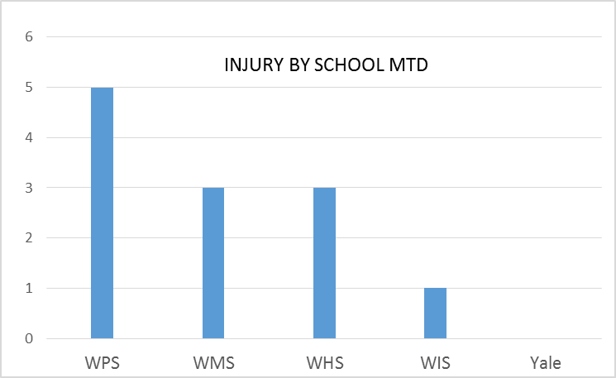
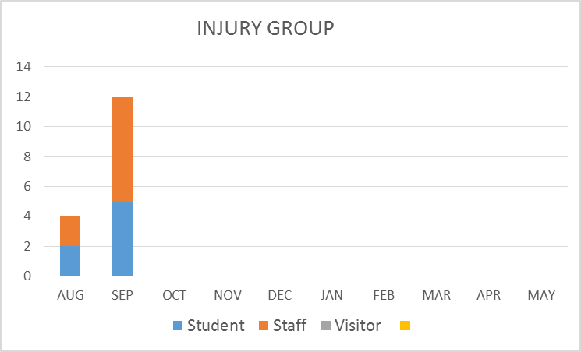
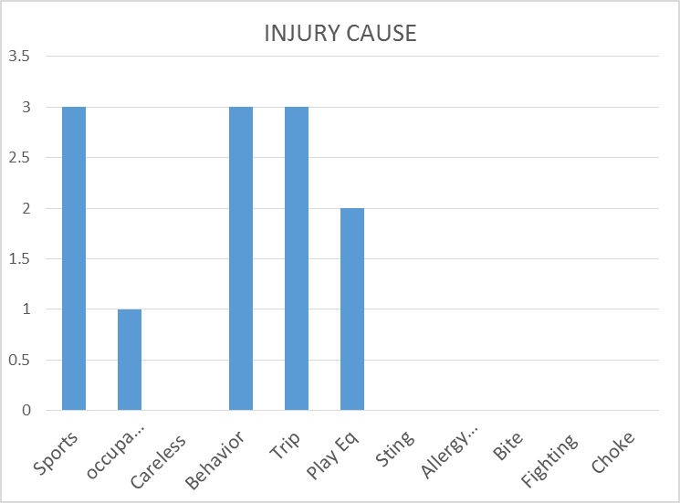
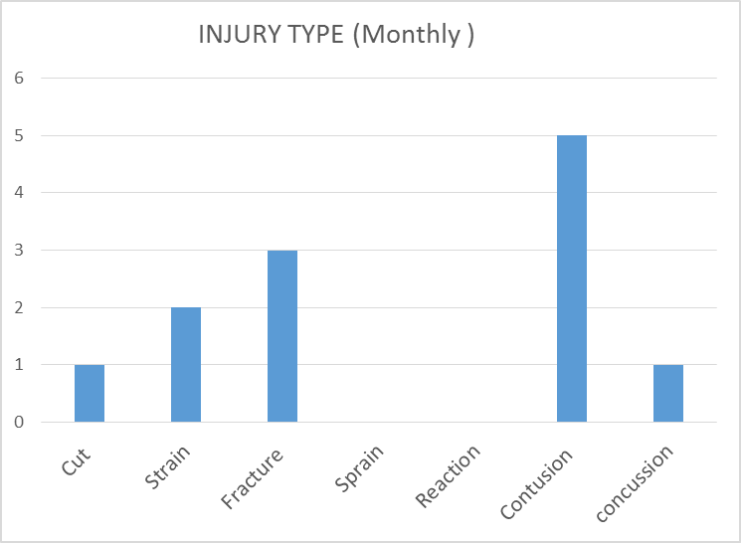
Safety Charts

